Slide 1
AUTOMATIC CARDIAC ARRHYTHMIAS CLASSIFICATION USING CNN AND ATTENTION-BASED RNN NETWORK JIE SUN
Course name: Distributed Computing System
Course code: CSE 707
Group no: 02
Submitted by
Arpita Roy
ID: 23266026
Department of CSE
BRAC University
Submitted to
Annajiat Alim Rasel
Senior Lecturer
Department of CSE
BRAC University

Slide 2
Content
Introduction
Background
Motivation
Methodology
Model architecture
Dataset
Data processing steps
Performance evaluation
Experimental result analysis
Accomplishment, limitation, and future work

Slide 3
INTRODUCTION BACKGROUND
Cardiac disease represents a major public health threat, with a death rate 32% higher than that of cancer, affecting around 0.29 billion individuals in China.
Early diagnosis is essential for reducing mortality and improving quality of life, and the electrocardiogram (ECG) is a key noninvasive and cost-effective diagnostic tool.
ECG waveform variations indicate arrhythmias, but chronic cardiac diseases and patient variability complicate diagnosis.
Despite deep learning advancements, challenges like data requirements, ECG variability, and imbalanced datasets hinder automatic arrhythmia classification.

Slide 4
INTRODUCTION MOTIVATION
The paper aims to improve automatic cardiac arrhythmia classification due to the high mortality rate of cardiac diseases.
Challenges like chronic conditions, ECG variability, and imbalanced datasets limit the effectiveness of current models.
The research integrates CNN, RNN, and attention mechanisms to develop a more accurate and robust model for better diagnosis and patient outcomes.

Slide 5
METHODOLOGY
Model Architecture
The proposed model combines two models-
Convolutional Neural Networks (CNN) : Extracting morphological features from the raw ECG signals
Gated Recurrent Unit (GRU) in the RNN: Captures long-term temporal dependencies in the extracted features.
1. CNN Module:
Consists of multiple layers: 1D convolutional layers, batch normalization, ReLU activation, dropout layers, and max pooling.
A Squeeze-and-Excitation (SE) module is incorporated to refine channel-wise feature maps, enhancing the model's ability to focus on important features.
2. Attention Mechanism:
An attention layer is added to the GRU module to highlight key information and dynamically weigh the importance of input features.
3. GRU Module:
The GRU module processes features extracted by the CNN.
It uses a bidirectional approach to capture both forward and backward temporal dependencies in ECG data.

Slide 6
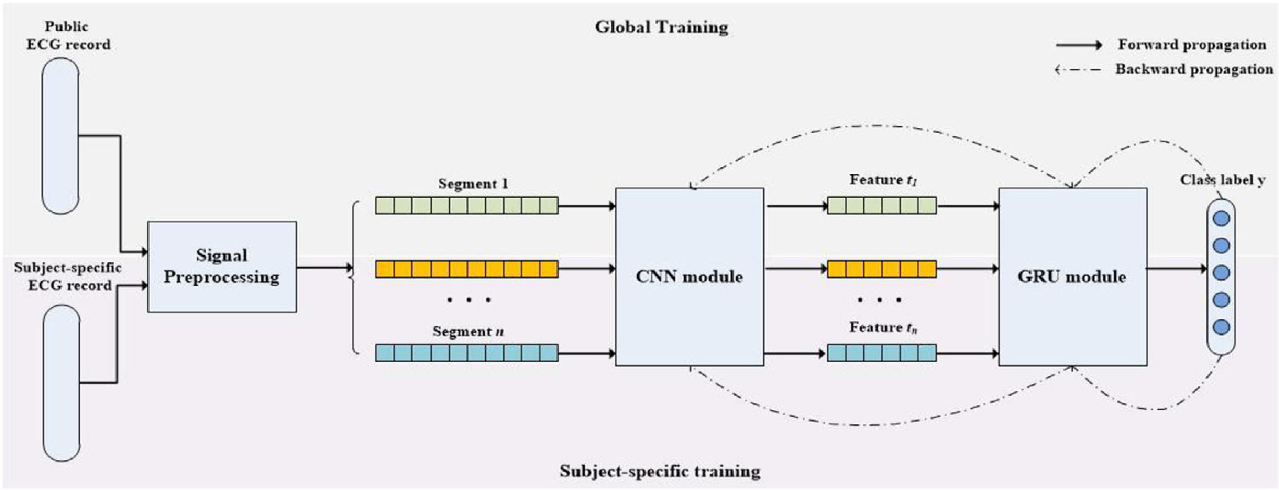
METHODOLOGY (CONT.)
4. Training Process:
The model undergoes two phases of training-
Global Training: A generalized model is trained on public datasets to learn common patterns across patients.
Subject-Specific Training: The generalized model is fine-tuned with patient-specific datasets to improve classification accuracy for individuals.
Fig-1: The block diagram of our proposed model. The neural network consisted of a CNN module and a GRU module. The training of the model includes global training and subject-specific training.

Slide 7
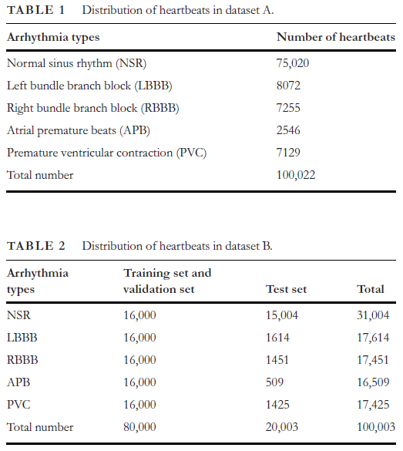
DATASET
MIT-BIH Arrhythmia Database (MITDB):
This dataset consists of 48 records obtained from 47 subjects, sampled at 360 Hz.
The dataset is known for its diverse range of arrhythmias, making it a valuable resource for training and evaluating classification models.
China Physiological Signal Challenge (CPSC) Dataset:
The CPSC dataset contains 9,831 12-lead ECG recordings from 9,458 subjects, sampled at 500 Hz.
This dataset includes a variety of arrhythmias and normal heartbeats, providing a comprehensive source of ECG data for model training and validation.
Subject-Specific Dataset:
A patient-specific dataset is collected from 80 individuals, where each person’s ECG signals are recorded for 1 minute, five times, resulting in a total of five minutes of data per subject.
This dataset is used for fine-tuning the generalized model to adapt to individual patient characteristics.
Dataset Construction: Two datasets are constructed for evaluation:
Dataset A: An unbalanced dataset containing heartbeats retrieved only from the MITDB.
Dataset B: A balanced dataset created by complementing the minority classes from the MITDB with records from the CPSC, ensuring equal representation of each arrhythmia type.

Slide 8
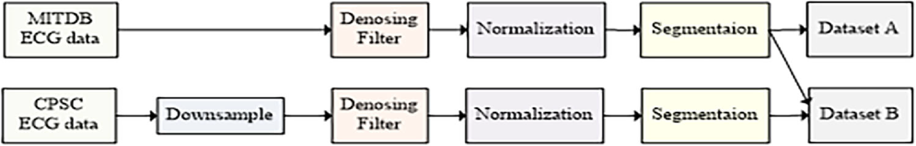
DATA PROCESSING STEPS
Signal Preprocessing:
The ECG signals from the CPSC dataset are downsampled from 500 Hz to 360 Hz to match the sampling rate of the MITDB records.
The signals are denoised and filtered to remove baseline wander using Daubechies wavelet transformation.
Normalization:
Each ECG signal is normalized using Z-score normalization to achieve a standard deviation of 1 and a mean of zero, ensuring uniformity across the dataset.
Segmentation:
The ECG signals are segmented based on the location of the R peak, identified using the Pan-Tompkins algorithm, which marks the beginning of a cardiac cycle.
Each segment is fixed to a length of 600 ms, consisting of 200 ms before the R peak and 400 ms after, resulting in 216 sample points per segment.
Fig-2: The preparation of datasets.

Slide 9
PERFORMANCE EVALUATION
The model's performance is assessed using various metrics, including sensitivity, specificity, precision, accuracy, and F1 score, to ensure a comprehensive evaluation of its classification capabilities.
These metrics are used to evaluate the model's performance on both the unbalanced dataset-A and the balanced dataset-B

Slide 10
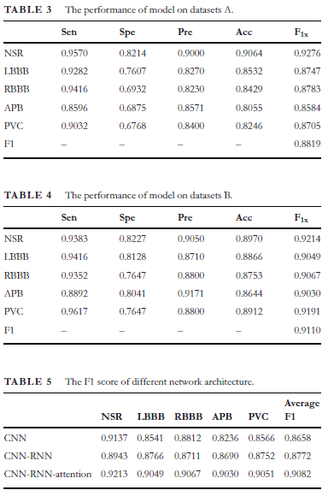
EXPERIMENTAL RESULT ANALYSIS
The experimental results of the proposed cardiac arrhythmia classification model demonstrate its effectiveness across two datasets:
Dataset A (Unbalanced Dataset):
Average F1 Score: 0.8819
The model showed high sensitivity for Normal Sinus Rhythm (NSR) and Atrial Premature Beats (APB), but varied specificity and precision, highlighting challenges in classifying less frequent arrhythmias.
Dataset B (Balanced Dataset):
Average F1 Score: 0.9110
The model performed better on the balanced dataset, with improved sensitivity for NSR (0.9383) and PVC (0.9617), reducing bias and increasing classification accuracy.
Comparison of Model Architectures:
It achieved an average F1 score of 0.9082.
The CNN-only model scored 0.8658, and the CNN-RNN model without attention scored 0.8772.

Slide 11
Accomplishment, limitation, and future work
Accomplishments:
Development of an Advanced Classification Model
Improved Classification Performance:
Addressing Data Imbalance
Two-Phase Training Approach
Comprehensive Evaluation Metrics
Potential for Clinical Application
Limitations:
Impact of Individual Variability on ECG Classification.
Impact of Dataset Imbalance on Arrhythmia Detection.
Future work:
Expanding datasets, developing real-time wearable applications, integrating multi-lead ECG signals, enhancing rare arrhythmia detection, and improving model interpretability for clinical use.
Email: arpita.roy1@g.bracu.ac.bd

